Slide 1
Organizational Structure and Design: an Introduction

Slide 2
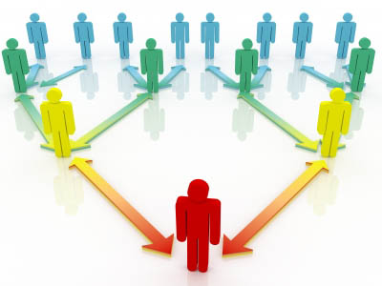
What is an Organization?

Slide 3
Organization
Organizing: Arranging the activities of the enterprise in such a way that they systematically contribute to the enterprise’s goals.
A deliberate arrangement of people to accomplish some specific purpose.
An organization is a consciously coordinated social entity, with an identifiable boundary, that functions on a relatively continuous basis to achieve a common goal or set of goals.

Slide 4
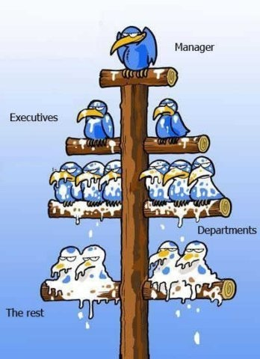
Organizational Structure

Slide 5
Organizational Structure
The formal system of task and authority relationships that control how people coordinate their actions and use resources to achieve organizational goals.
It defines how task are to be allocated, who reports to whom, and the formal coordinating mechanisms and interaction patterns that will be followed.

Slide 6
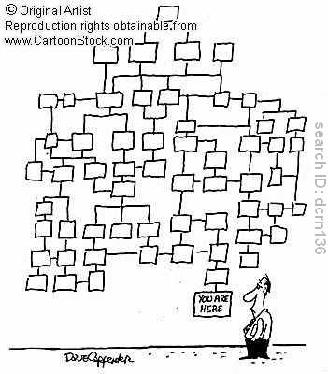

Slide 7
Components of Organizational Structure
Complexity: extent of differentiation within the organization.
Formalization: extent of rules and procedures present to direct behaviour of the employees.
Centralization: locus of decision-making authority (concentration of formal authority).

Slide 8
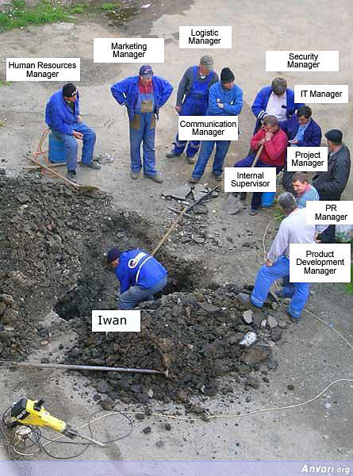
Organizational Complexity

Slide 9
Organizational Design and Theory
Organization Design: Concerned with constructing and changing an organization’s structure to achieve the organization’s goals.
Organization Theory (OT): discipline that studies structure , design and culture of organizations.
Contrasting OB and OT :
OB : takes a micro view – emphasizing individuals and small groups.
OT : takes a macro perspective. Unit of analysis is the organization itself.

Slide 10
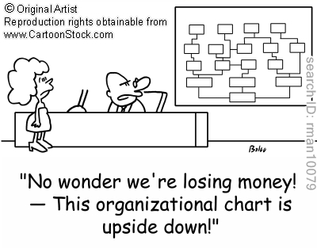

Slide 11
The Organization
Strategy
Environment
Technology
Structure
Formalization
Specialization
Hierarchy
Centralization
Culture
Size

Slide 12
Why organizations exist?
Organizations exist to create value in society by satisfying certain needs of its stakeholders.

Slide 13
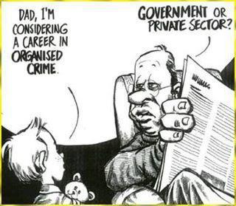

Slide 14
Creating Value
Increase specialization &
Division of labour
Use large
scale technology
The use of an
organization allows
people jointly to:
Manage the external environment
Which increases the
value that an
organization can
create
Economize on transaction costs
Exert power and control
Notes:
v

Slide 15
How an organization creates value
Inputs
Raw materials Money & capital Human resources Information and knowledge
Conversion process
Machinery Computers Human skills & abilities
Environment
Customers Shareholders Suppliers Distributors Government Competitors
Outputs
Finished goods Services Dividends Salaries Value for shareholders

Slide 16
Perspectives on Organizations
Rational entities
Coalitions of powerful constituencies
Capitalistic structures
Instruments of domination
http://www.youtube.com/watch?v=8SuUzmqBewg&feature=relmfu
Open systems

Slide 17
Systems Perspective
A system is a set of interrelated and interdependent parts arranged in a manner that produces a unified whole. (e.g. societies, automobiles, plants, human bodies).
Subsystems within larger systems.
Interrelationship of parts within the system.
Differentiation Vs Integration .
Closed systems and open systems.

Slide 18
The Closed System
Views system as self-contained
Ignores effect of environment
Receives no energy from outside, no energy released to its surroundings

Slide 19
Open systems
Recognizes dynamic interaction of system
with its environment
Environment
System
Inputs
Transformation
process
Outputs
Environment

Slide 20
The organization as an open system
Goals & values
subsystems
Culture
Philosophy
Overall goals
Group goals
Individual goals
Technical subsystem
Knowledge
Techniques
Facilities
Equipment
Managerial subsystems
Goal setting
Planning
Assembling resources
Organizing
Implementing
Controlling
Outputs
Products
Services
Human
satisfaction
Org.survival
& growth
Social
benefit
Inputs
Material
Money
Human effort
Information
Psychosocial subsystem
Human resources
Attitudes
Perceptions
Motivations
Group dynamics
Leadership
Communication
Interpersonal relations
Structural
Subsystem
Tasks
Workflow
Work groups
Authority
Information flow
Procedures
Rules
Feedback

Slide 21
An Industrial Organization as an Open System
Technical processing
Core
(transforming r/m
into finished product)
Inputs
- Materials
- Labor
- Capital
Output:
Finished
product
Customers
Regul-ations
Lobbying
Consumer advocacy
Government
Receipt of revenue
Repayment of
loans
Financial institutions
Labour force
Wages
Suppliers
Payment to
creditors

Slide 22
Characteristics of an Open System
Environment awareness : concept of boundaries
New organizational forms redefine concept of boundaries
Feedback
Cyclical character
Negative entropy
Steady state
Movement towards growth and expansion
Balance of maintenance and adaptive activities
Equifinality
Importance of the systems perspective

Slide 23
The life-cycle perspective
Life cycle stages:
Entrepreneurial stage:
Formation, ambiguous goals, high creativity, requires steady supply of resources
Population ecology theory – “liability of newness”
Collectivity stage:
Mission clarified, communication & structure informal, high member commitment
Institutional theory – “Organizational isomorphism”
Formalization-and-control stage:
Structure stabilizes, rules, procedures imposed, innovation de-emphasized, conservative decision making, role clarity, organization exists beyond individual
Elaboration-of-structure stage:
Product diversification, growth opportunities sought, structure more complex, decentralization
Decline stage
Shrinking market, increased competition, employee turnover, increased conflicts, centralized decision making under new leadership

Slide 24
Organizational Life Cycle
maturity
Decline
Growth
Formation
Decline stage:
High employee turnover
Increased conflict
centralization
Collectivity stage:
Informal communication
High commitment
F & C stage:
Formalization of rules
Stable structure
Emphasis on efficiency
E of S stage:
More complex str
decentralizn
Diversified markets
Entrepreneurial stage:
Ambiguous goals
High creativity

Slide 25
Stages of corporate lifecycle:Adizes
Courtship stage
Infancy (infant mortality)
Go-go stage (founders’ trap)
Adolescence stage
Prime stage
Stability stage
Aristocracy stage
Recrimination stage
Bureaucracy
Death

Slide 26
Greiner’s Model of Organizational Growth
Large
Stage 1
Stage 2
Stage 3
Stage 4
Stage 5
Stage 6
5. Crisis of ??
4. Crisis of red-tape
Size of organization
3. Crisis of control
2. Crisis of autonomy
Growth thru’ collaboration
1. Crisis of leadership
Growth thru’ coordination
Growth thru’ delegation
Growth thru’ direction
Growth thru’ creativity
Small
Young
Age of Organization
Mature

Slide 27
The changing paradigm of organization design: from efficient performance to learning organization
From vertical to horizontal structure
From routine tasks to empowered roles
From formal control systems to shared information
‘Learning’ organization ‘teaching’ organization
From competitive to collaborative strategy
From rigid to adaptive culture

